Slide 1
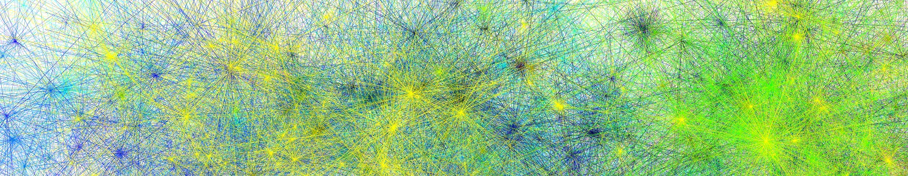
Open Science Practices for Linguists
James Brand
Edge Hill University
james.brand@edgehill.ac.uk
18/08/25 – USC Dornsife

Slide 2
Slides:
https://tinyurl.com/NZLS-workshop

Slide 3
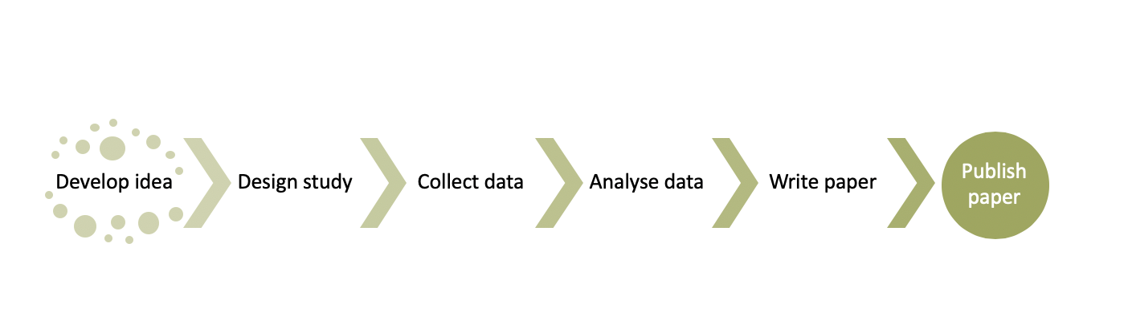
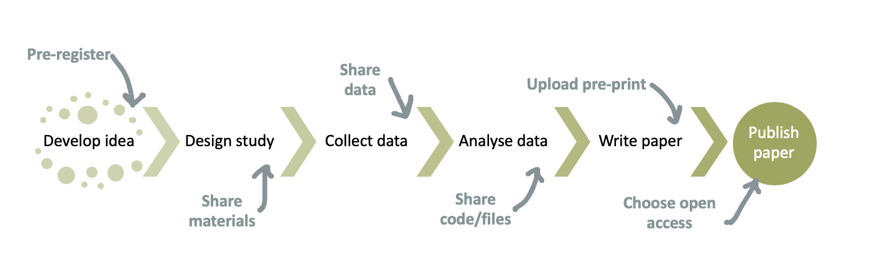
What is Open Science?
There are lots of definitions...
In it's simplest form... just doing 'normal' science but more transparently

Slide 4
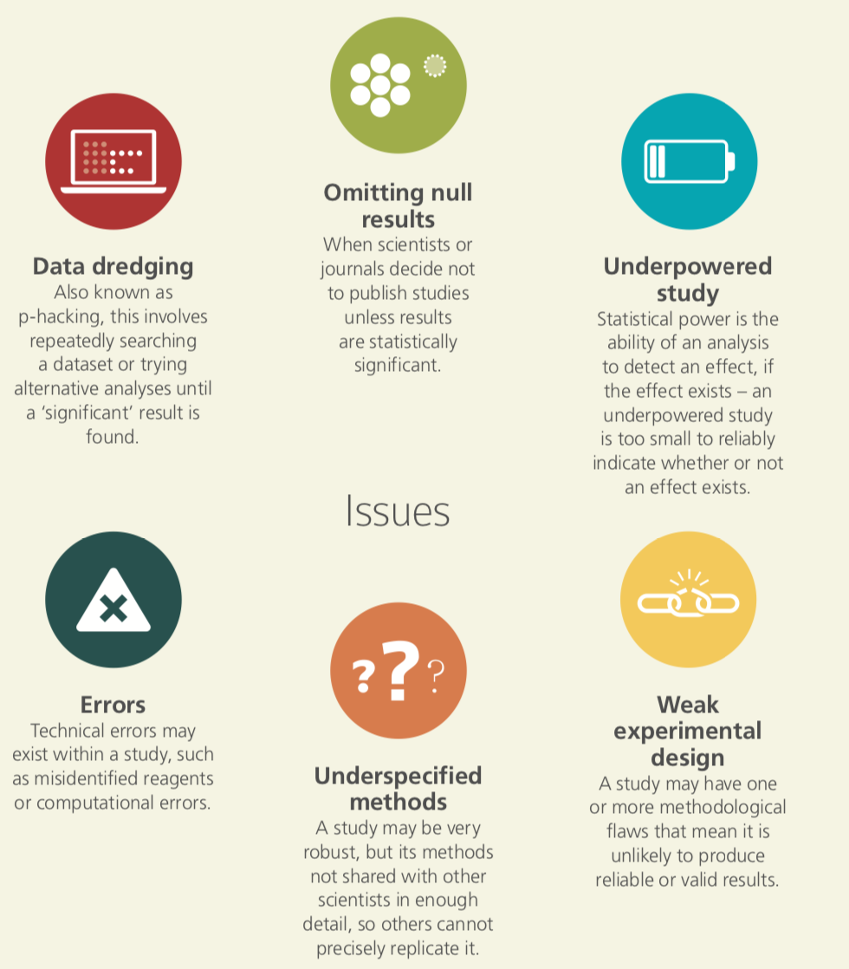
The times they are a changin'
Academy of Medical Sciences (https://acmedsci.ac.uk/file-download/38208-5631f0052511d.pdf)

Slide 5
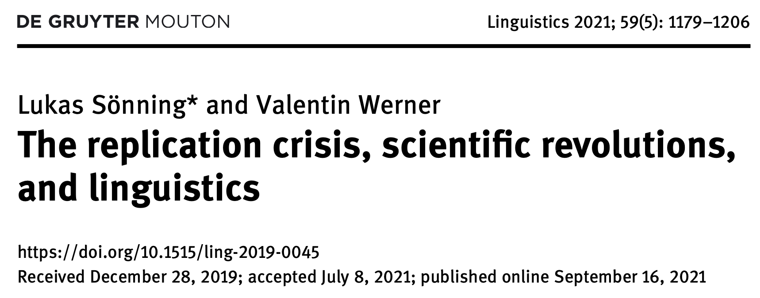
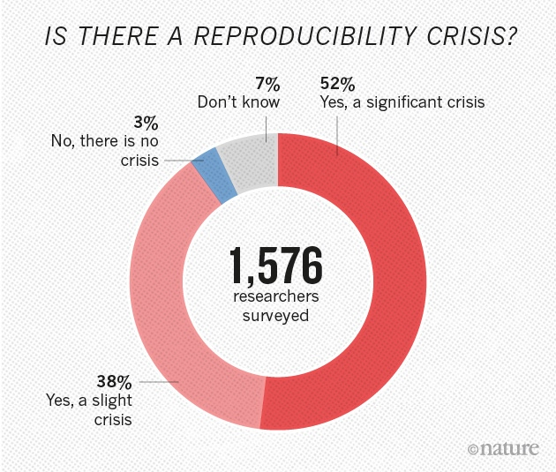
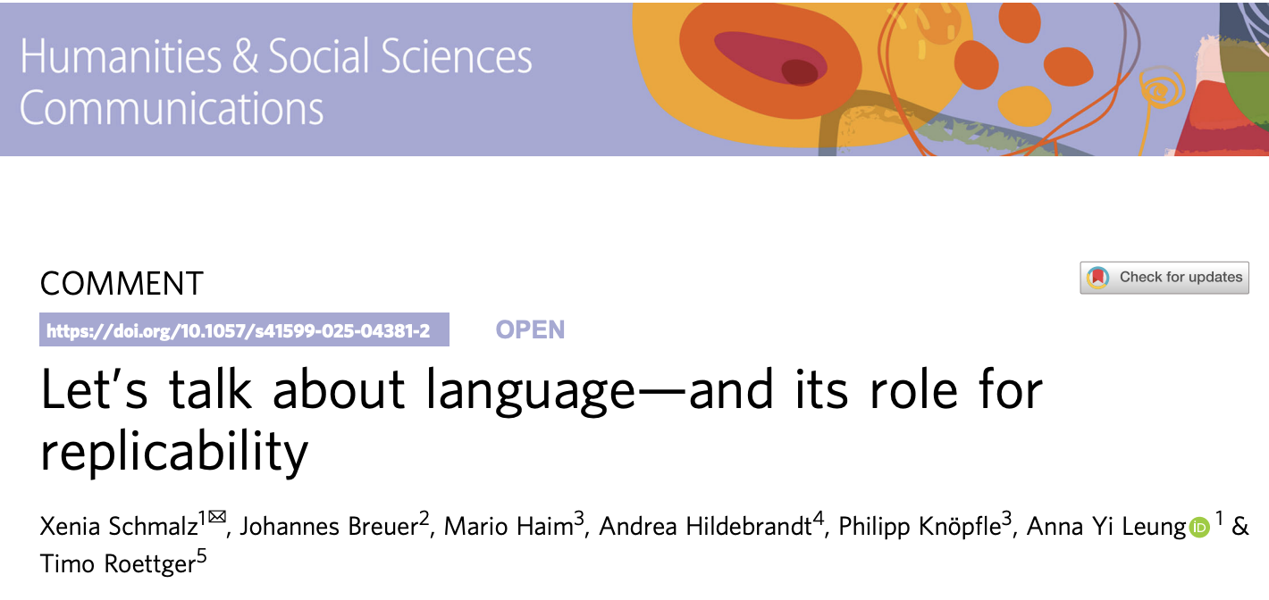
The times they are a changin'
Sönning & Werner (2021)
Baker (2016)
Schmalz et al. (2025)

Slide 6
1. Replicability

Slide 7
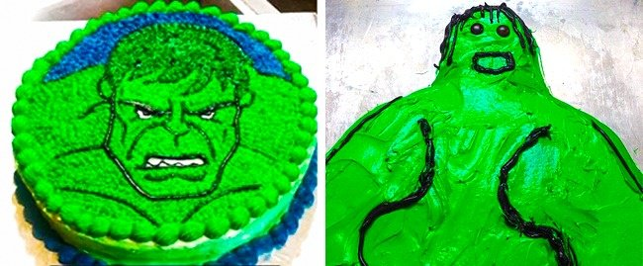
Replicability
The ability to replicate the work of somebody else, using independently collected data, but derived from the same methods
https://www.awesomeinventions.com/cake-fails/

Slide 8
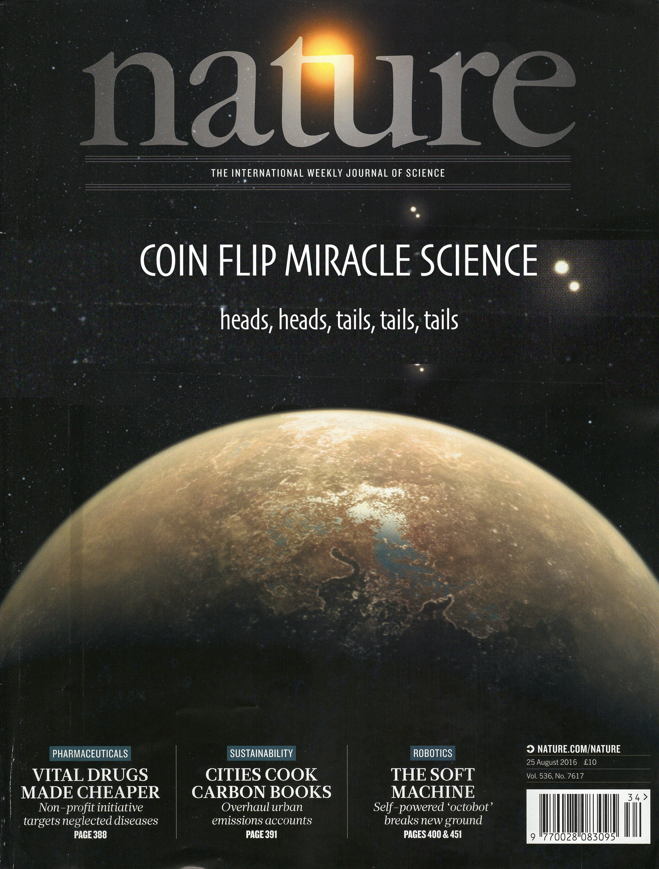
Replicability
Hypothesis: Flipping a coin 5 times gives this sequence:
heads, heads, tails, tails, tails
Method: Flip a coin 5 times
Result: heads, heads, tails, tails, tails

Slide 9
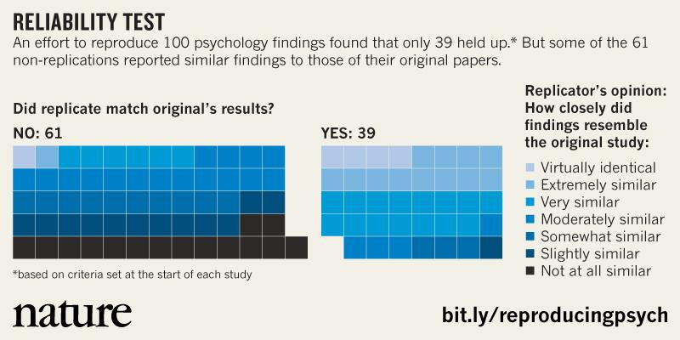
Replicability
Baker (2015)

Slide 10
Replicability
Why is it important?
"The scientifically significant physical effect may be defined as that which can be regularly reproduced by anyone who carries out the appropriate experiment in the way prescribed"
Popper (1952: 23-24)

Slide 11
Replicability
Replications are not a good use of time and resources, they do not warrant publication
Sure, they do take time and resources. If the original paper did not find the same result, would it have been published? Should we value null results the same way as significant results?
Who gets to decide which is the correct result?
Nobody. But perhaps it can stimulate discussion between groups when different results are found and understand why that might be.

Slide 12
Replicability
The replication did not give the same result... this is because the participants were too different
Sure, there will be differences from the original sample. Can this be explained from a theoretical standpoint? If so, was it mentioned in the original submission?
The replication did not give the same result... this is because the experiment was not run correctly
Sure, no replication will be exactly the same. Did the original submission give enough reproducible information to run it correctly?

Slide 13
2. Reproducibility

Slide 14
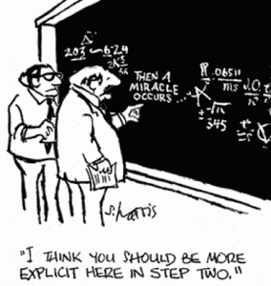
Reproducibility
The ability to reproduce the work of somebody else by using the same methods, data and analyses, as was originally reported
http://www.sciencecartoonsplus.com/pages/gallery.php

Slide 15
Reproducibility
Hypothesis:
Women are taller than men
Method:
Looked at various pictures of women and men in 3 different contextual settings
Result:
Women are taller than men, p < 0.001
https://datacolada.org/31

Slide 16
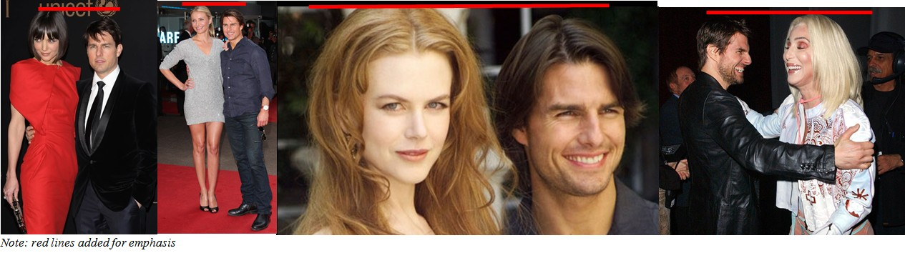
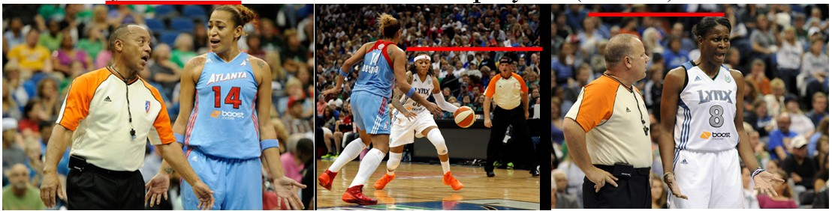
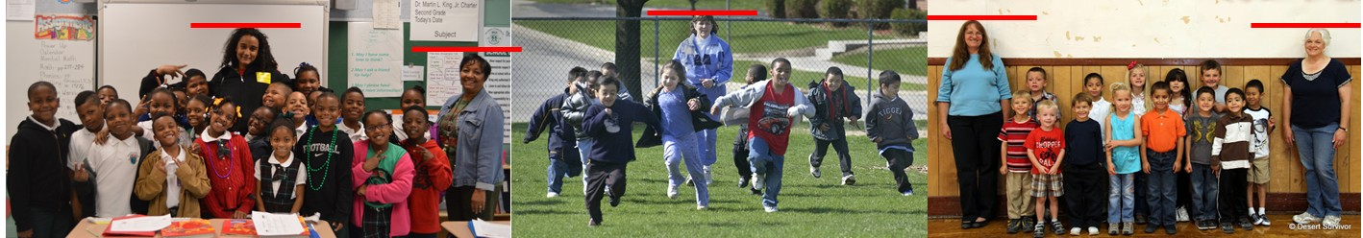
Reproducibility
Just because it is reproducible, doesn't make it reliable evidence
https://datacolada.org/31

Slide 17

Reproducibility
https://datacolada.org/31

Slide 18
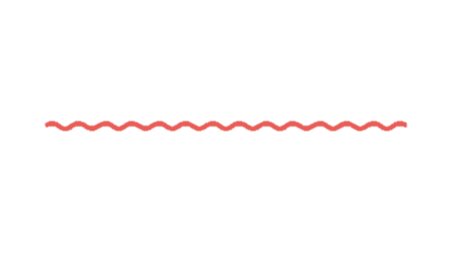
Reproducibility
Small steps towards being more reproducible:
Share your data, code, materials, anything that you have
Ensure the things you share can be understood by others
Don't manually edit data files (e.g. Excel) then overwrite the master file
Try to code, not click
Identifly errors, don't hide them

Slide 19
Reproducibility
Ways being reproducible makes things easier (for others):
1. It allows others to understand your workflow
2. It allows others to learn
3. It allows others to pick up where you left off
4. It allows other to reproduce your work
5. It allows others to identify errors

Slide 20
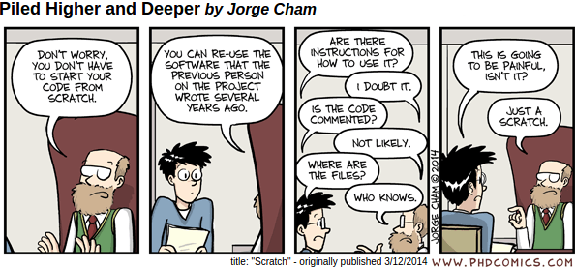
Reproducibility

Slide 21


Reproducibility
https://github.com/nzilbb/Covariation_monophthongs_NZE
https://osf.io/q4j29/

Slide 22
3. Publishing

Slide 23
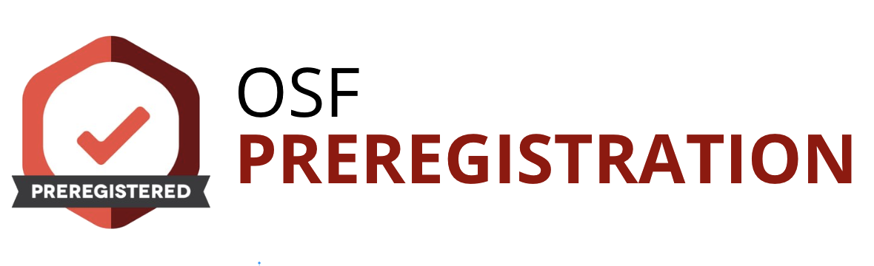
Pre-registration
The process of declaring key aspects of your research plan, prior to actually undertaking the research, using a time-stamped document
https://osf.io/registries/osf/new

Slide 24
Pre-registration
Why bother?
p-hacking: when you decide to modify, change or adjust the original analysis approach to find your p < 0.05 result
HARKing (Hypothesising After Results are Known): when you decide to modify, change or adjust the original hypotheses to suit your p < 0.05 result
Pre-registration facilitates openness about what your original intentions were

Slide 25
Pre-registration
p-hacking example
You generate a hypothesis
You collect data from 15 participants to test the hypothesis
You choose to look at the data from 10 participants and run your analyses
The results are significant
You think you should probably collect more data, but decide not to

Slide 26
Pre-registration
HARKing example
You generate a hypothesis
You collect data from 50 participants
You choose to look at the data and run your analyses
The results do not support your hypothesis
You change your hypothesis and generate a new one that suits the results

Slide 27
Pre-registration
If I pre-register, am I stuck with that plan forever?
No. You can update your pre-registration in response to the development of the project. Just try to avoid doing so after data collection. Or state in publication any deviations from original plan.
If I pre-register, do I have to state a clear hypothesis?
No. Hypotheses can be confirmatory, where you have a clear prediction about your results, or they can be exploratory, where you do not have a clear prediction about the results. Both are fine! As long you specify in the first instance.

Slide 28
Pre-registration
Does it have to be very detailed?
No. You can add as much detail as you want. Just be clear and honest.
Does it take long?
No. They can be completed in a few minutes. Deciding what to pre-register might take longer, but that is the reason pre-registration is sensible... it lets you decide on what you are going to do.
What if things don't turn out as I predicted?
That is doing science! If your results don't match your expectations, that is the result to report, there will be a reason why. Ultimately, these results should carry the same weight as 'publishable' results.

Slide 29
Registered Reports
Submit your research plan for peer-review, before data collection and analysis, normally with provisional acceptance to the journal.
Benefits?
Makes any result a 'worthy' result
See https://cos.io/rr/

Slide 30
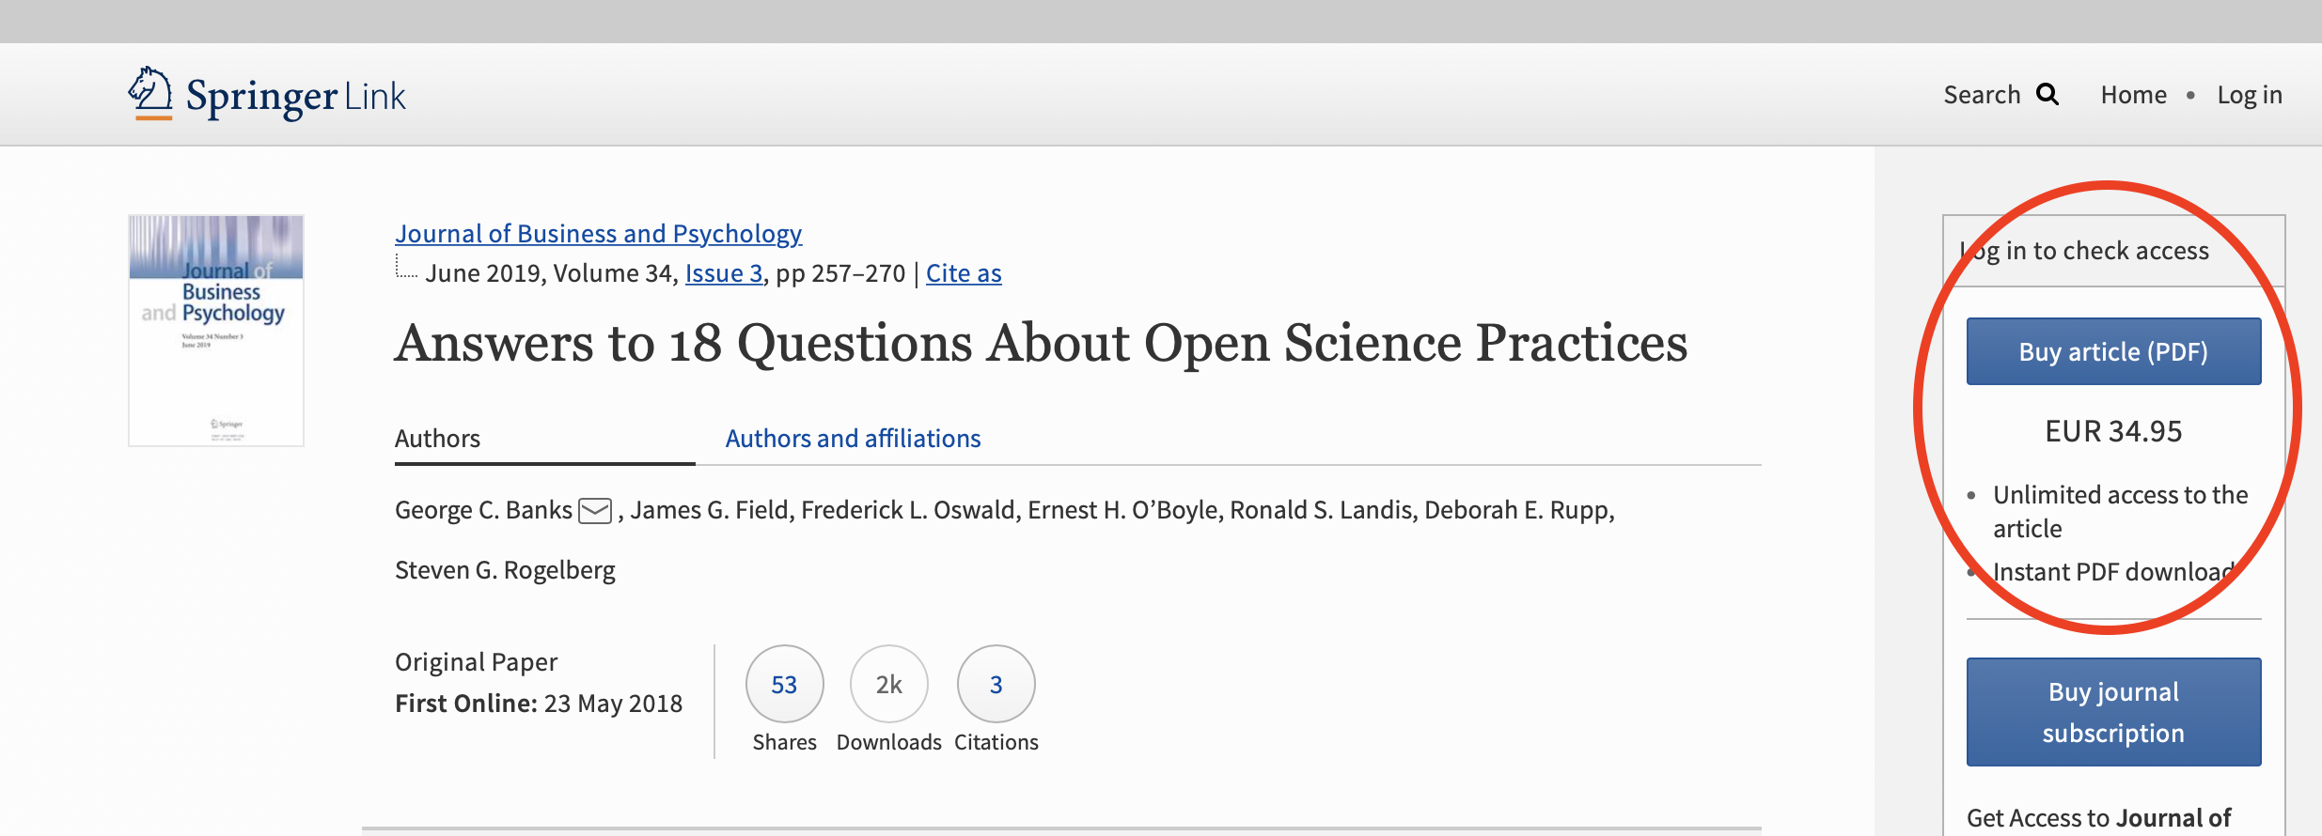
Open access
Making your research available and accessible online, for free, for everybody
Banks et al. (2019)

Slide 31
Open access
Different routes to Open Access?
Green: Allows users to deposit work prior to publication on accessible archive
Gold: Makes the final published article accessible to all through the journal, at a cost to the author
Diamond/platinum: Essentially the gold route, but with no charge to the the author

Slide 32
Open access
What types of licenses?
Adding a license to your work is always useful as it can restrict or open the access of it.
https://creativecommons.org/choose/

Slide 33
Open access
Pre-prints
You can archive your pre-submitted manuscript, i.e. before it has undergone peer review at at journal
There are lots of options to do this, they are normally free (e.g. PsyArXiv)
They are time-stamped, so harder to plagiarize
Gets your work out there faster
Journals normally fine with this practice
Pre-prints example: https://osf.io/preprints

Slide 34
4. Big-team science

Slide 35
Big-team science
Collaborative research model: Large groups of researchers, often across institutions and countries, work together on shared scientific projects.
Scale of participation: Typically involves dozens to hundreds (sometimes thousands) of researchers contributing.
Shared goals: Designed to tackle questions that are too resource-intensive, complex, or broad for a single lab to address alone.
Standardisation: Methods, protocols, and analyses are agreed upon collectively to ensure consistency across teams.

Slide 36
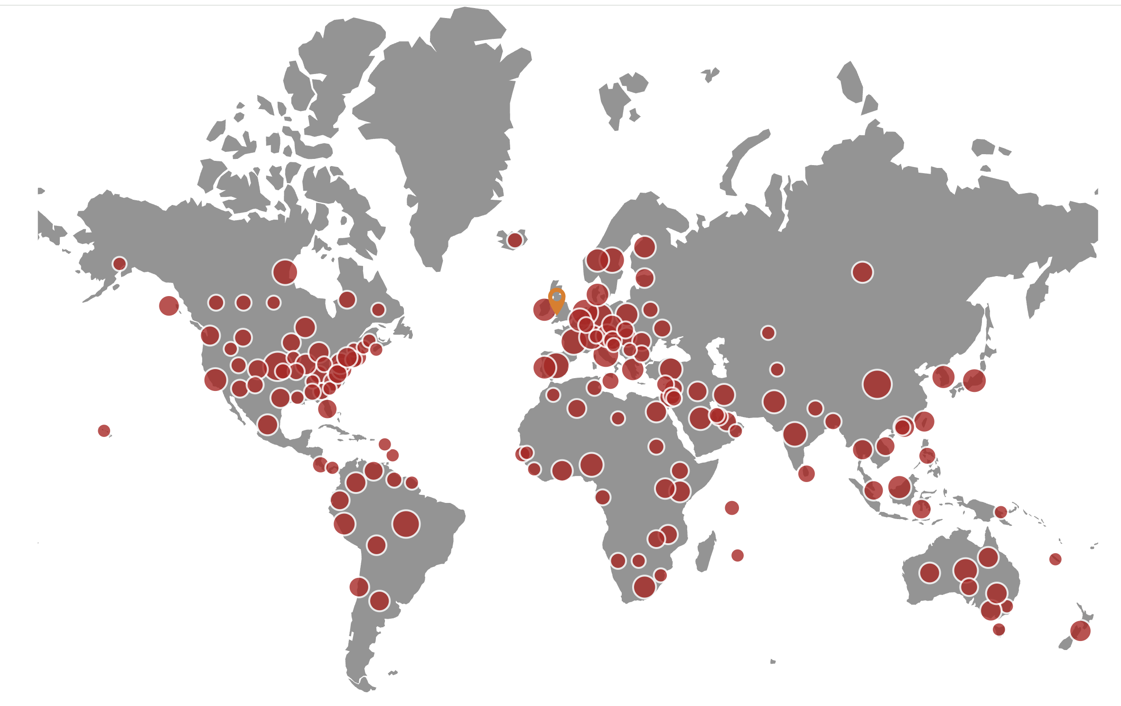
Big-team science

Slide 37

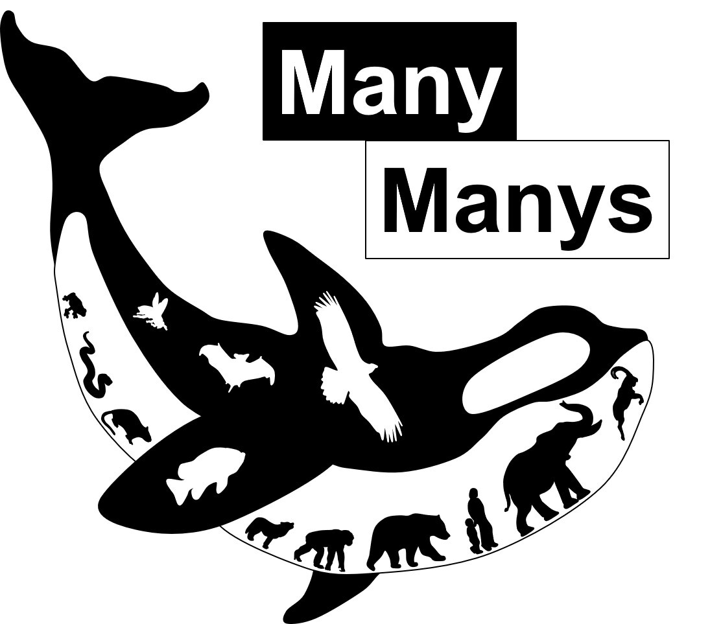

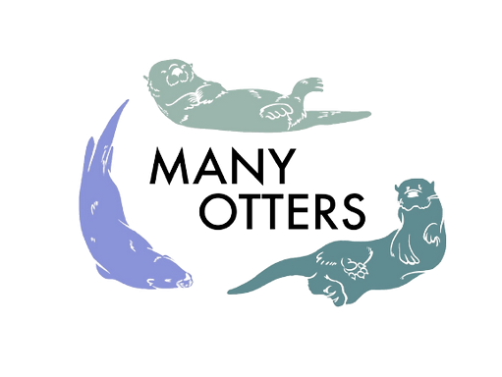


Big-team science

Slide 38
Thanks!

